Slide 1
Logical reasoning systems
Theorem provers and logic programming languages
Production systems
Frame systems and semantic networks
Description logic systems

Slide 2
Logical reasoning systems
Theorem provers and logic programming languages – Provers: use
resolution to prove sentences in full FOL. Languages: use backward
chaining on restricted set of FOL constructs.
Production systems – based on implications, with consequents
interpreted as action (e.g., insertion & deletion in KB). Based on
forward chaining + conflict resolution if several possible actions.
Frame systems and semantic networks – objects as nodes in a
graph, nodes organized as taxonomy, links represent binary
relations.
Description logic systems – evolved from semantic nets. Reason
with object classes & relations among them.

Slide 3
Basic tasks
Add a new fact to KB – TELL
Given KB and new fact, derive facts implied by conjunction of KB and new fact. In forward chaining: part of TELL
Decide if query entailed by KB – ASK
Decide if query explicitly stored in KB – restricted ASK
Remove sentence from KB: distinguish between correcting false sentence, forgetting useless sentence, or updating KB re. change in the world.

Slide 4
Indexing, retrieval & unification
Implementing sentences & terms: define syntax and map sentences onto machine representation.
Compound: has operator & arguments.
e.g., c = P(x) ∧ Q(x) Op[c] = ∧; Args[c] = [P(x), Q(x)]
FETCH: find sentences in KB that have same structure as query.
ASK makes multiple calls to FETCH.
STORE: add each conjunct of sentence to KB. Used by TELL.
e.g., implement KB as list of conjuncts
TELL(KB, A ∧ ¬B) TELL(KB, ¬C ∧ D)
then KB contains: [A, ¬B, ¬C, D]

Slide 5
Complexity
With previous approach,
FETCH takes O(n) time on n-element KB
STORE takes O(n) time on n-element KB (if check for duplicates)
Faster solution?

Slide 6
Table-based indexing
Use hash table to avoid looping over entire KB for each TELL or FETCH
e.g., if only allowed literals are single letters, use a 26-element array to store their values.
More generally:
- convert to Horn form
- index table by predicate symbol
- for each symbol, store:
list of positive literals
list of negative literals
list of sentences in which predicate is in conclusion
list of sentences in which predicate is in premise

Slide 7
Tree-based indexing
Hash table impractical if many clauses for a given predicate symbol
Tree-based indexing (or more generally combined indexing):
compute indexing key from predicate and argument symbols
Predicate?
First arg?

Slide 8
Unification algorithm
Using clever indexing, can reduce number of calls to unification
Still, unification called very often (at basis of modus ponens) => need efficient implementation.
See AIMA p. 303 for example of algorithm with O(n^2) complexity
(n being size of expressions being unified).

Slide 9
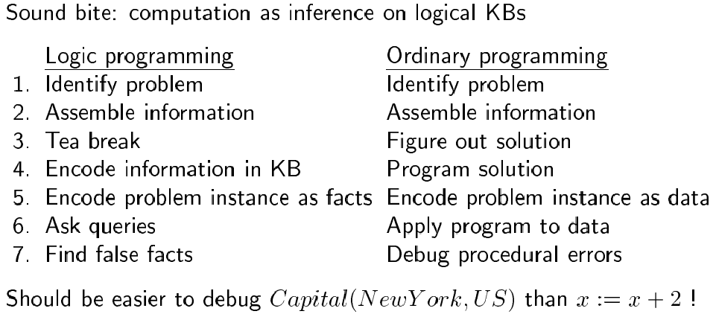
Logic programming
Remember: knowledge engineering vs. programming…

Slide 10
Logic programming systems
e.g., Prolog:
Program = sequence of sentences (implicitly conjoined)
All variables implicitly universally quantified
Variables in different sentences considered distinct
Horn clause sentences only (= atomic sentences or sentences with no negated antecedent and atomic consequent)
Terms = constant symbols, variables or functional terms
Queries = conjunctions, disjunctions, variables, functional terms
Instead of negated antecedents, use negation as failure operator: goal NOT P considered proved if system fails to prove P
Syntactically distinct objects refer to distinct objects
Many built-in predicates (arithmetic, I/O, etc)

Slide 11
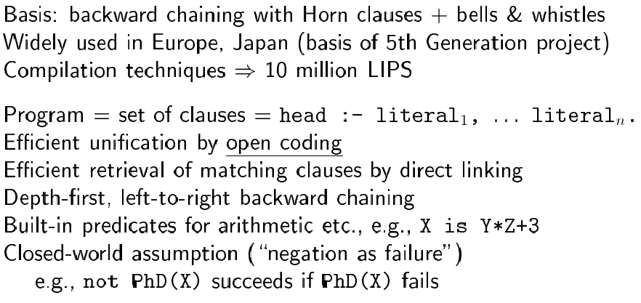
Prolog systems

Slide 12
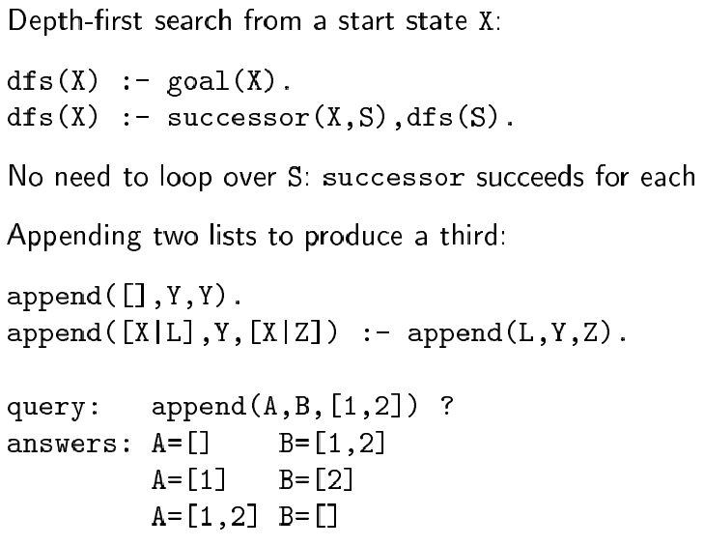
Prolog example

Slide 13
Expanding Prolog
Parallelization:
OR-parallelism: goal may unify with many different literals and
implications in KB
AND-parallelism: solve each conjunct in body of an implication
in parallel
Compilation: generate built-in theorem prover for different predicates in KB
Optimization: for example through re-ordering
e.g., “what is the income of the spouse of the president?”
Income(s, i) ∧ Married(s, p) ∧ Occupation(p, President)
faster if re-ordered as:
Occupation(p, President) ∧ Married(s, p) ∧ Income(s, i)

Slide 14
Theorem provers
Differ from logic programming languages in that:
- accept full FOL
- results independent of form in which KB entered

Slide 15
OTTER
Organized Techniques for Theorem Proving and Effective Research (McCune, 1992)
Set of support (sos): set of clauses defining facts about problem
Each resolution step: resolves member of sos against other axiom
Usable axioms (outside sos): provide background knowledge about domain
Rewrites (or demodulators): define canonical forms into which terms can be simplified. E.g., x+0=x
Control strategy: defined by set of parameters and clauses. E.g., heuristic function to control search, filtering function to eliminate uninteresting subgoals.

Slide 16
OTTER
Operation: resolve elements of sos against usable axioms
Use best-first search: heuristic function measures “weight” of each clause (lighter weight preferred; thus in general weight correlated with size/difficulty)
At each step: move lightest close in sos to usable list, and add to usable list consequences of resolving that close against usable list
Halt: when refutation found or sos empty

Slide 17
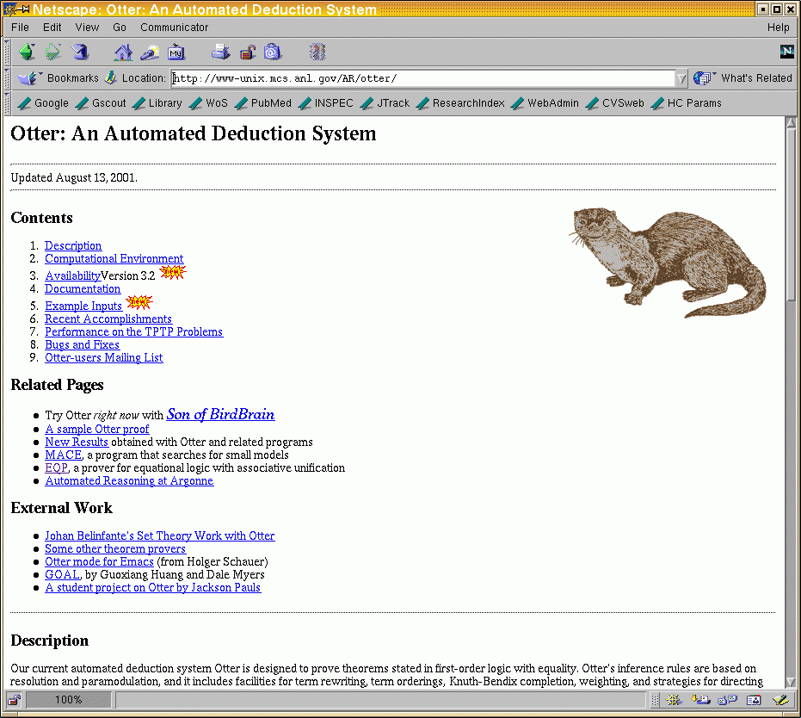
Example

Slide 18
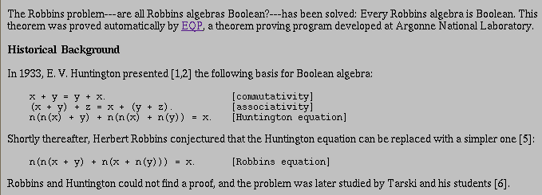

Slide 19
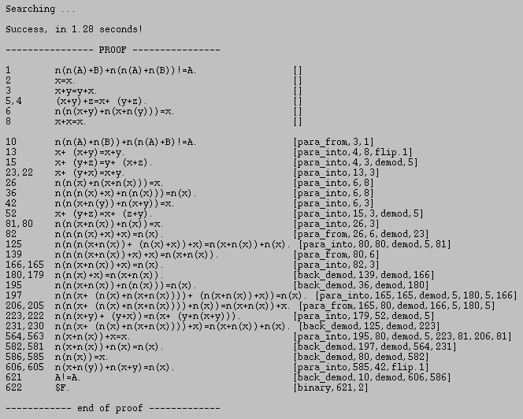

Slide 20
Forward-chaining production systems
Prolog & other programming languages: rely on backward-chaining
(I.e., given a query, find substitutions that satisfy it)
Forward-chaining systems: infer everything that can be inferred from KB each time new sentence is TELL’ed
Appropriate for agent design: as new percepts come in, forward-chaining returns best action

Slide 21
Implementation
One possible approach: use a theorem prover, using resolution to forward-chain over KB
More restricted systems can be more efficient.
Typical components:
- KB called “working memory” (positive literals, no variables)
- rule memory (set of inference rules in form
p1 ∧ p2 ∧ … ⇒ act1 ∧ act2 ∧ …
- at each cycle: find rules whose premises satisfied
by working memory (match phase)
- decide which should be executed (conflict resolution phase)
- execute actions of chosen rule (act phase)

Slide 22
Match phase
Unification can do it, but inefficient
Rete algorithm (used in OPS-5 system): example
rule memory:
A(x) ∧ B(x) ∧ C(y) ⇒ add D(x)
A(x) ∧ B(y) ∧ D(x) ⇒ add E(x)
A(x) ∧ B(x) ∧ E(x) ⇒ delete A(x)
working memory:
{A(1), A(2), B(2), B(3), B(4), C(5)}
Build Rete network from rule memory, then pass working memory through it

Slide 23
Rete network
D A=D add E
A B A=B C add D
E delete A
C(5)
D(2)
A(1),
A(2)
B(2),
B(3),
B(4)
A(2),
B(2)
Circular nodes: fetches to WM; rectangular nodes: unifications
A(x) ∧ B(x) ∧ C(y) ⇒ add D(x)
A(x) ∧ B(y) ∧ D(x) ⇒ add E(x)
A(x) ∧ B(x) ∧ E(x) ⇒ delete A(x)
{A(1), A(2), B(2), B(3), B(4), C(5)}

Slide 24
Advantages of Rete networks
Share common parts of rules
Eliminate duplication over time (since for most production systems only a few rules change at each time step)

Slide 25
Conflict resolution phase
one strategy: execute all actions for all satisfied rules
or, treat them as suggestions and use conflict resolution to pick one action.
Strategies:
- no duplication (do not execute twice same rule on same args)
- regency (prefer rules involving recently created WM elements)
- specificity (prefer more specific rules)
- operation priority (rank actions by priority and pick highest)

Slide 26
Frame systems & semantic networks
Other notation for logic; equivalent to sentence notation
Focus on categories and relations between them (remember ontologies)
e.g., Cats Mammals
Subset

Slide 27
Semantic network link types
Link type Semantics Example
A B A ⊂ B Cats Mammals
A B A ∈ B Bill Cats
A B R(A, B) Bill 12
A B ∀x x ∈ A ⇒ R(x, B) Birds 2
A B ∀x ∃y x ∈ A ⇒ y ∈ B ∧ R(x, y) Birds Birds
Subset
Subset
Member
Member
R
Age
R
Legs
R
Parent

Slide 28
Description logics
FOL: focus on objects
Description logics: focus on categories and their definitions
Principal inference tasks:
- subsumption: is one category subset of another?
- classification: object belings to category?

Slide 29
CLASSIC
And(concept, …)
All(RoleName, Concept)
AtLeast(Integer, RoleName)
AtMost(Integer, RolaName)
Fills(RoleName, IndividualName, …)
SameAs(Path, Path)
OneOf(IndividualName, …)
e.g., Bachelor = And(Unmarried, Adult, Male)

